Slide 1
Form Validation in JS

Slide 2
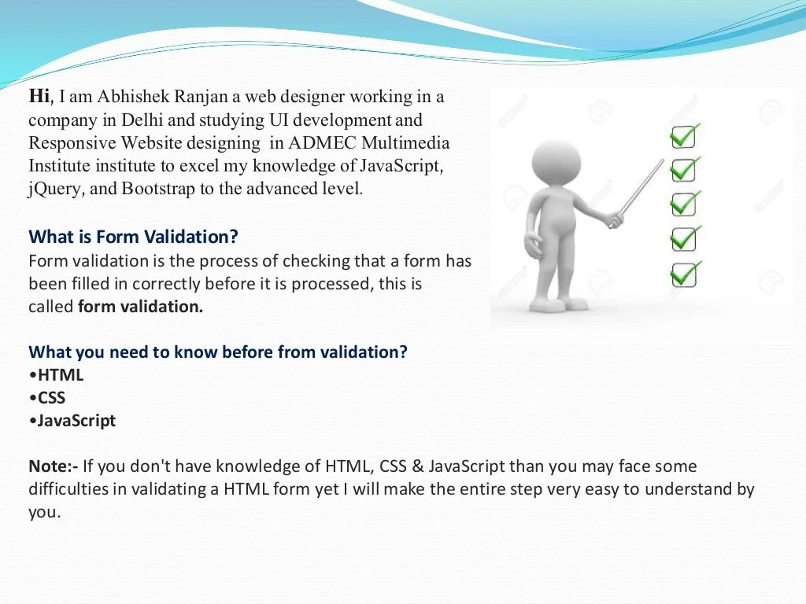
Form Validation In JS

Slide 3
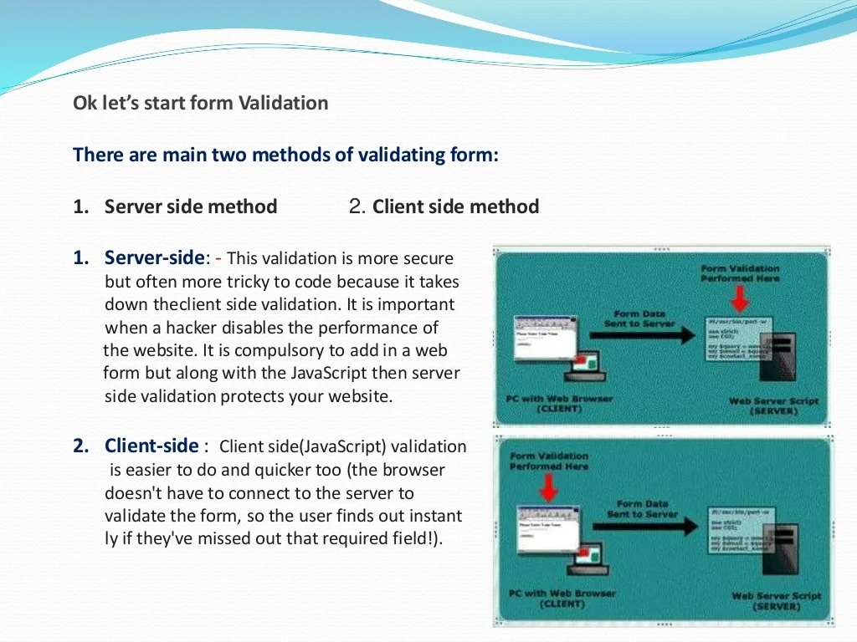

Slide 4
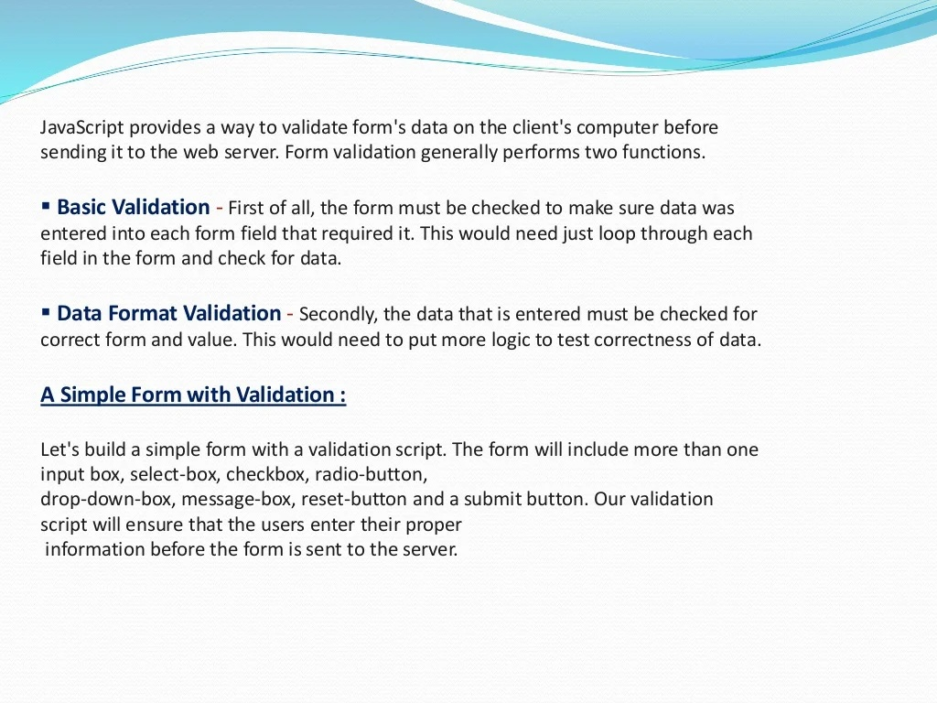

Slide 5
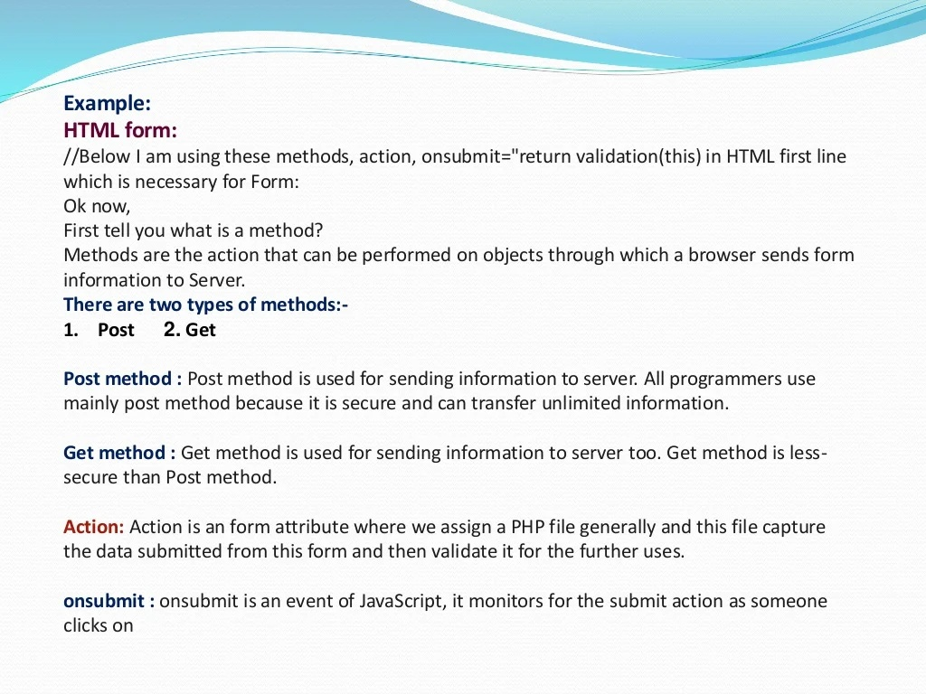

Slide 6
Implementation
Open VS Code for Practice

